Slide 1
Laser Star Guide
Created by Zack Mason, Ethan Plantilla, Axel Garces, Eddy Meraz, Ezequiel Contreras Morales
Notes:
Zack

Slide 2
Requirements
App
Constellation name, history, lore, etc. using Stellarium.org
User interface
Slideshows/auto features
Translated into multiple languages
Notes:
Ezequiel

Slide 3
Device
Housing built for outdoors and uneven terrain
GPS
Device orientation and calibration , Polar alignment , self leveling
Laser projection using 2 mirror galvos
Points to specified Star locations
Database of celestial bodies
Integration with smartphone
Safety feature
Find the optimal safe distance of device from user
Automatic shut down
Notes:
zeke

Slide 4
Ethics Issues Lead to Project Changes
FFA has a federal law that states: a person convicted of aiming a laser pointer at a plane, could lead to time in prison (up to five years).
Additionally, they may face fines from the FAA of up to $11,000 per violation, and up to $200,000 for multiple incidents.
Creating a database from a book was not possible because we didn’t have permission from the book publisher.
Notes:
zack

Slide 5
Technical Limitations Lead to Project Changes
Lack of internet access when using the device
Limited Hardware capabilities
Limited Funding (more precise hardware is very expensive)
Notes:
Ethan

Slide 6
Reinvisioned Goals for the Project
Create a device that allows the user to point a laser into the sky automatically with minimal control inputs.
Implement an app that can be used to control device, and translate into multiple human languages.
The app also needs to provide information about constellations that is not copyright
Safety implementations so that people don’t do anything illegal
Notes:
Zeke
In the beginning our goal was to create a design that can point a laser into the sky that has minimal control inputs.
It will work similar to a telescope where it will work on declination, right ascension, and distance.
Have a similar database to Stellarium
Which is a free open source planetarium.
If possible draw out the constellation.

Slide 7
Security & Safety
There are not many cyber security risks because our device mainly works offline
There is no use of personal information in our app
High powered lasers are very dangerous
Using Flight radar to check flight paths in the location where you use the device
Notes:
Eddy
We didn't need many cyber security risk or threats because our device is offline. No personal information was collected in our app. We were mainly focused on the safety aspect of our project.
These included dealing with high powered lasers
We Also used a flight radar to check for flight paths. Thereforth, you can make sure no planes around your location (to prevent you from point lasers at planes)

Slide 8
The Device

Slide 9
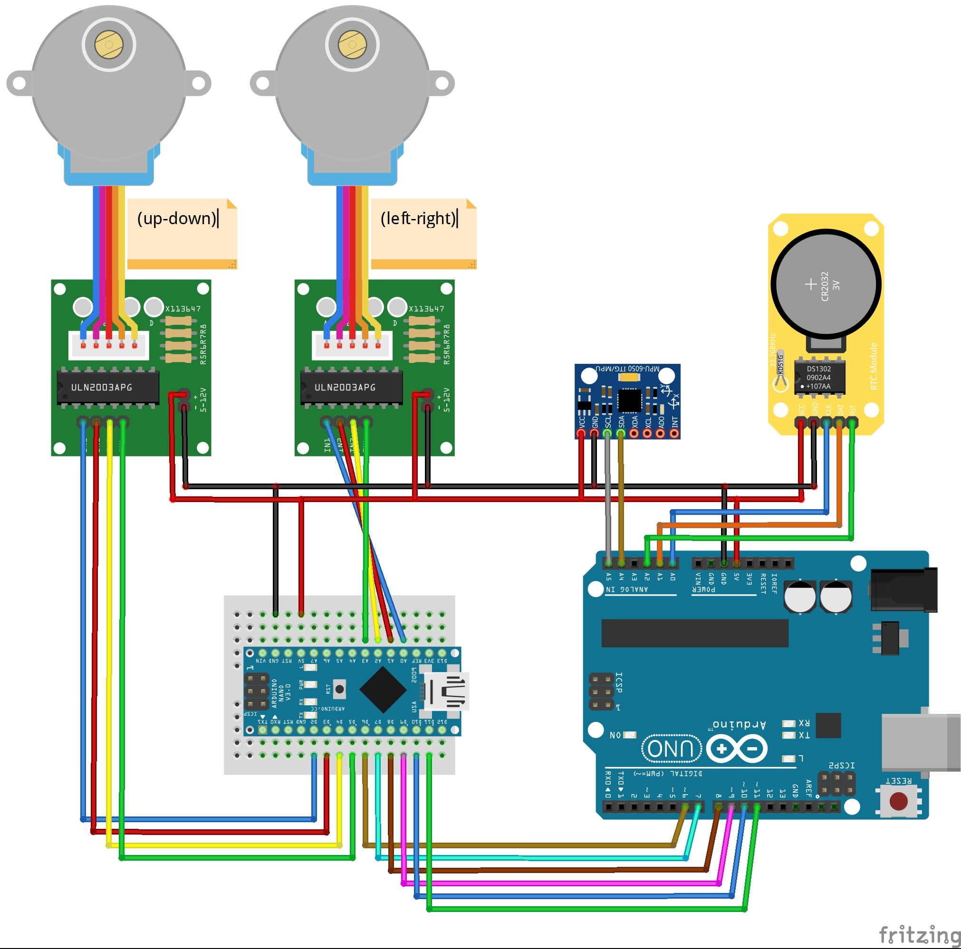
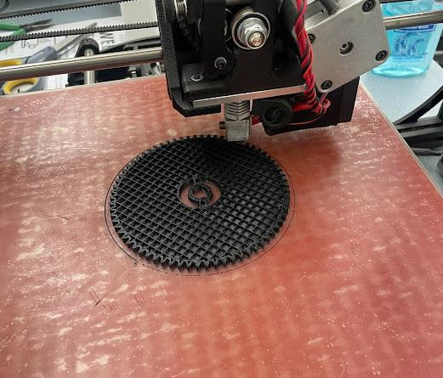
Device Design
Used an Arduino and a wifi connection to control our laser
Tinkercad models of 3D printed parts
Layouts and circuits design for the device
Notes:
Ethan

Slide 10
Goto Laser
To begin the laser we started with a simple 1D test to set objects
Moved to a system where the 1D test rotates on a plate to give the second dimension in order to cover the full view of the sky
The plate and laser rotate using steppers motors for precise movements
Using arduino we can control the motors
Started with physical joystick and integrated one into the app
Notes:
Ethan

Slide 11

Goto Laser
1D Laser Test
2D Laser Test
Notes:
Ethan Show project demo here.

Slide 12
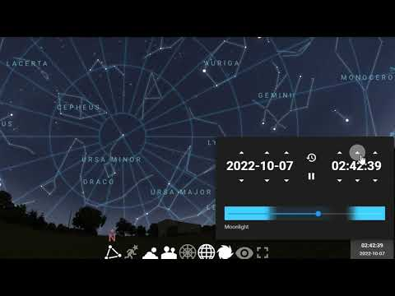
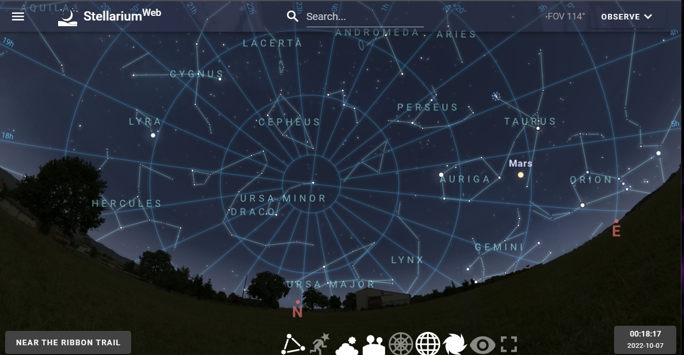
Goto Laser
Similar to a go to telescope, our device will project a laser beam into the night sky at a desired constellation
Uses Equaitorial System
RA and DEC
Stellarium gif
Notes:
Ethan

Slide 13
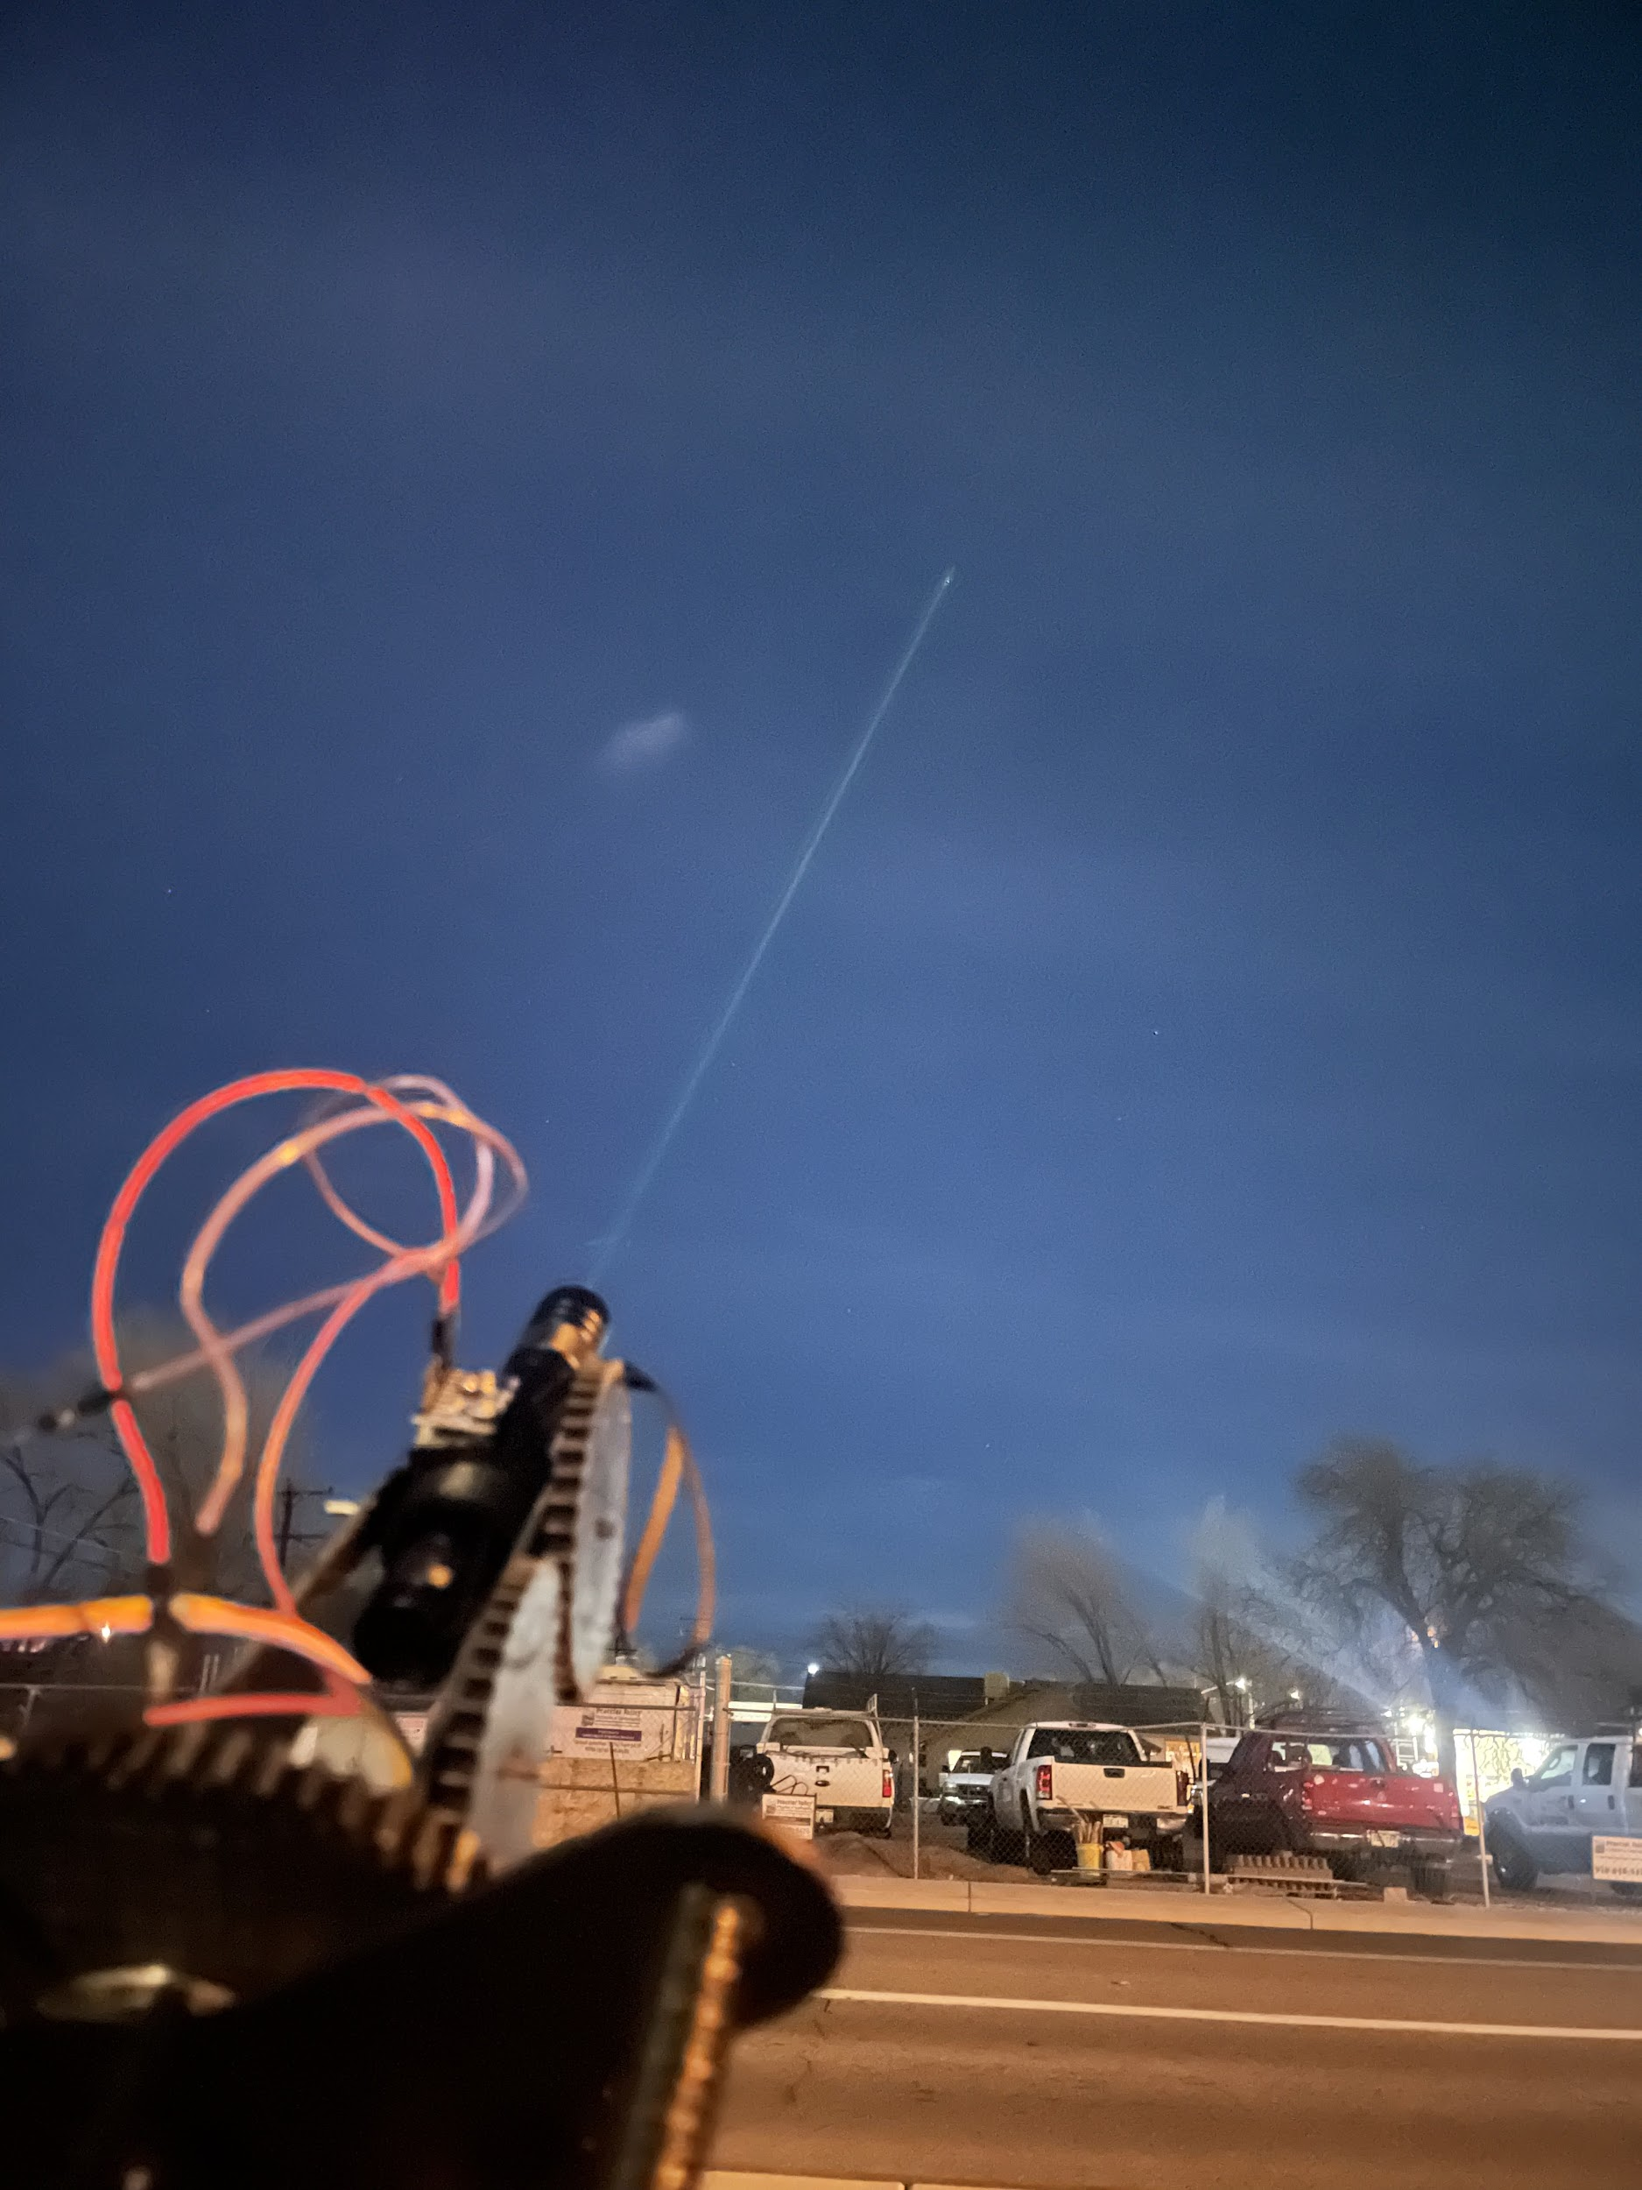
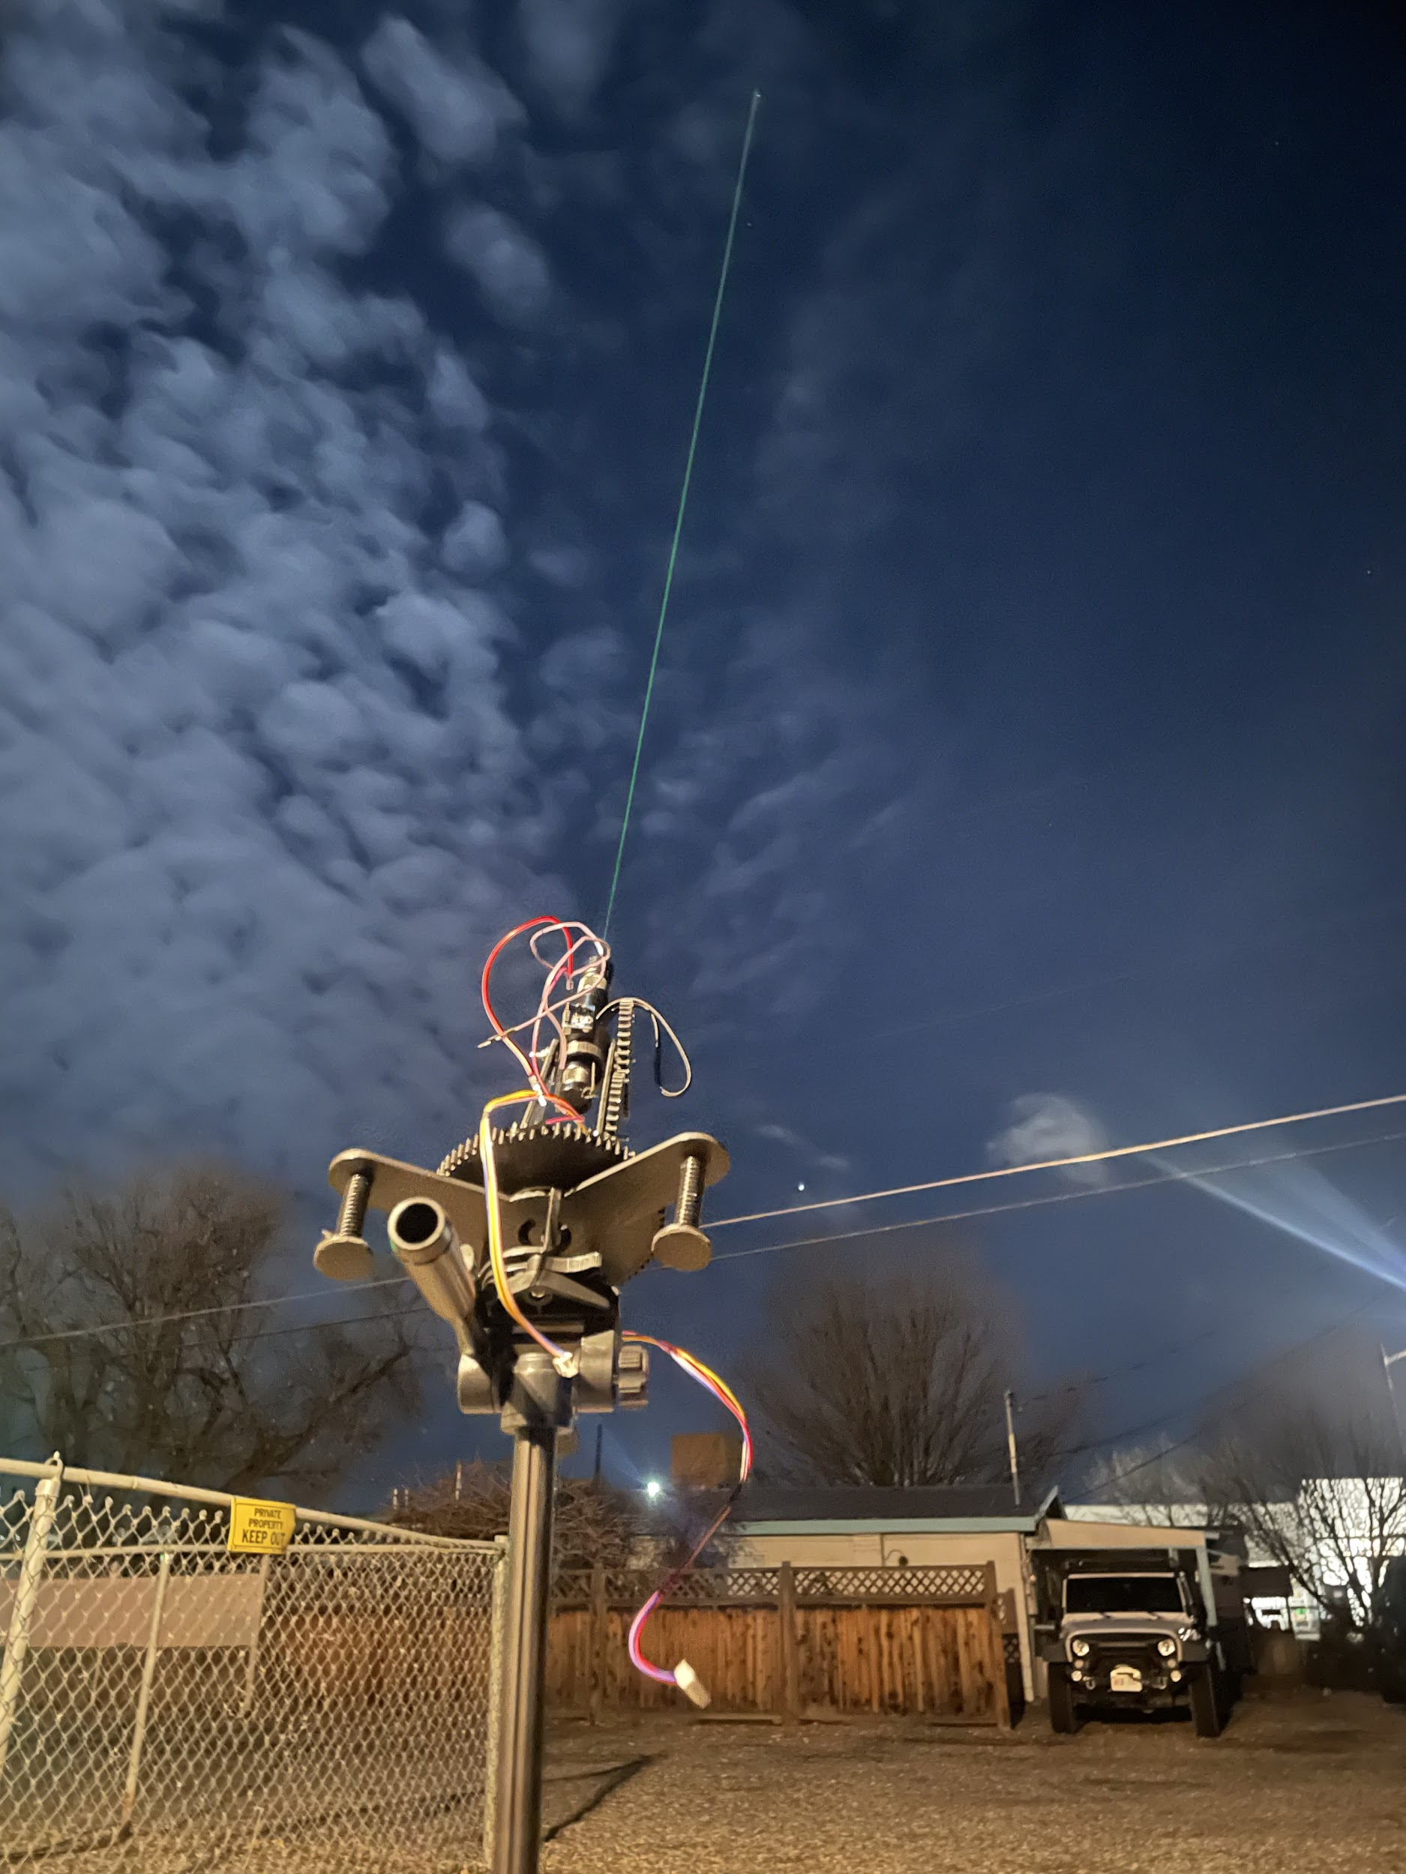
Laser Photos

Slide 14
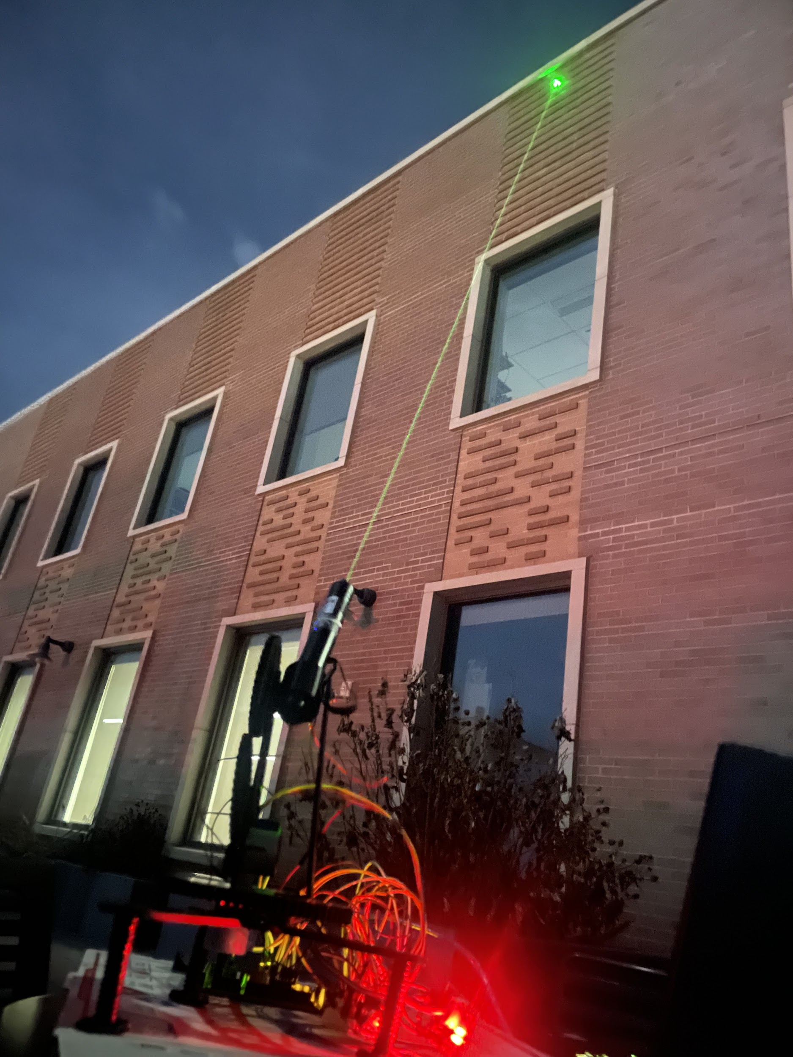
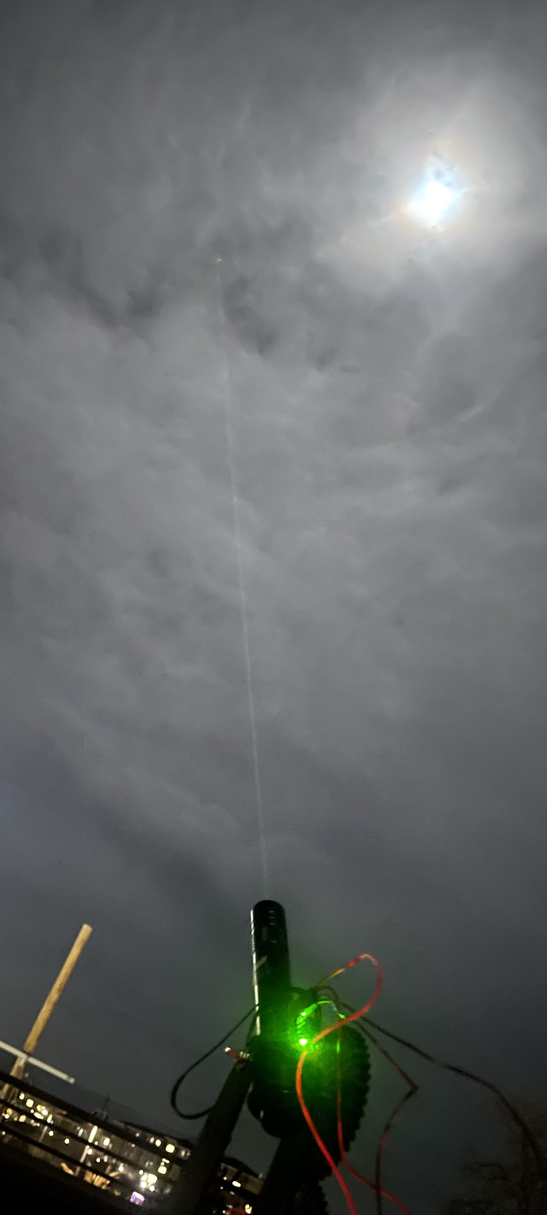
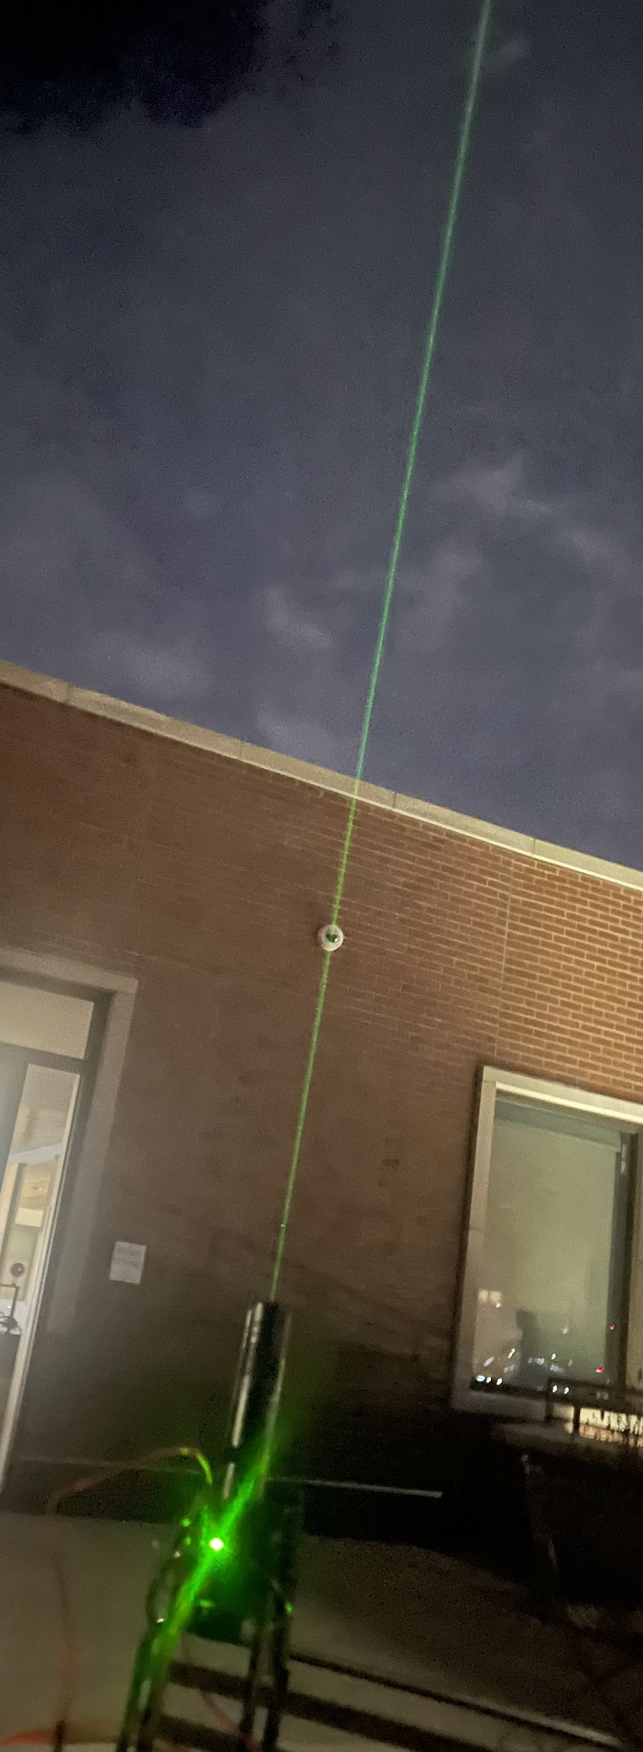
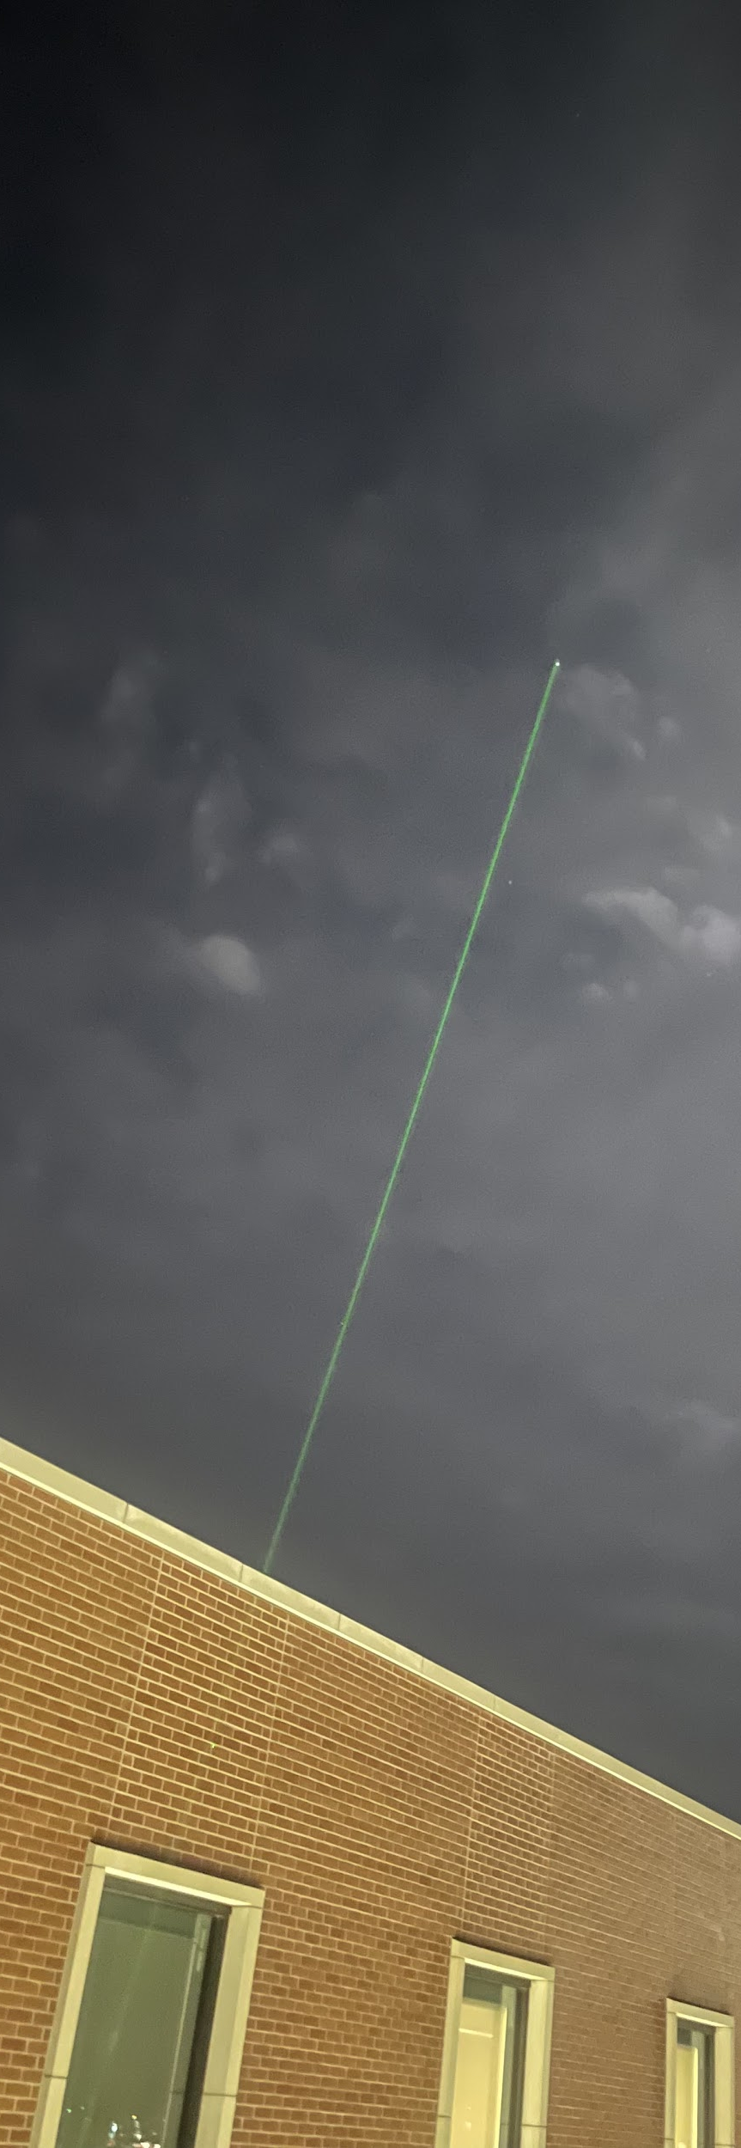

Slide 15
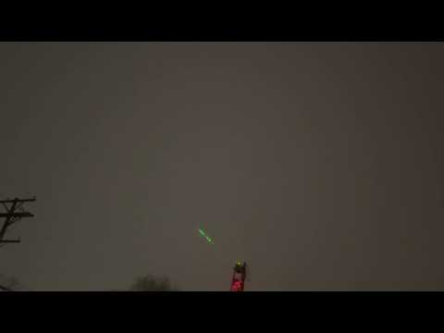
Laser Video
Laser Video

Slide 16
Laser Projection
The laser projector uses galvos that vibrate mirrors to create an image
Script to convert gcode for CNC machines into arduino hex code
DAC from arduino to galvo driver boards
Needs to be connected to wall outlet
Bulky and hard to move
Notes:
Ethan

Slide 17
Using ESP8266 to connect to StarGuide
Uses wifi to allow devices to connect to it
Soft Access point
HTML page for easy interaction with ESP without having the app on our phones
Submitting a form does a get request which then saves the value as a string
The command is sent serially to the arduino controlling the motors
Eventually integrate it directly into our app using rest api
Notes:
Zack

Slide 18
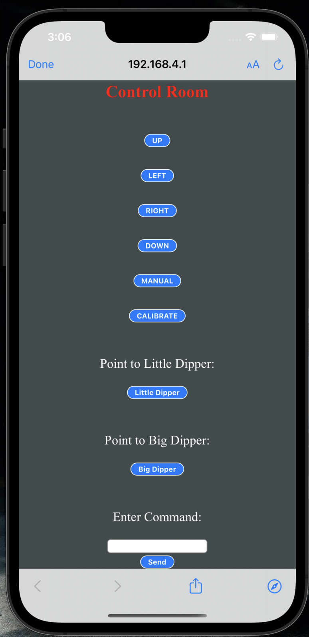
Notes:
Zack

Slide 19
Testing
Testing serial communication on ESP.
Using AssertEqual to test serial communication.
User End Testing:
We had multiple students and client test our app throughout the process.
This gave us feedback and ideas to make it more user friendly.
Testing Hardware:
Voltmeter to test hardware and signal flow.
Notes:
Zack

Slide 20
The Software

Slide 21

Flutter Application
Simultaneous development of both Android and IOS
Uses a programming language called Dart
Supported by Google
Open Source
Good documentation from native flutter
Everything is a Widget
Hot Restart feature that allows instant update to changes on app as we are developing.
Notes:
Axel

Slide 22
Downside to using Flutter
Newer framework are constantly getting new updates
Deprecated libraries
Updated libraries not compatible with older libraries causing crashes.
Libraries are open sourced and not always maintained.
Can’t implement some features that would work for IOS and Android both.
Brand new language to us, which meant lots of RND
Notes:
Axel

Slide 23
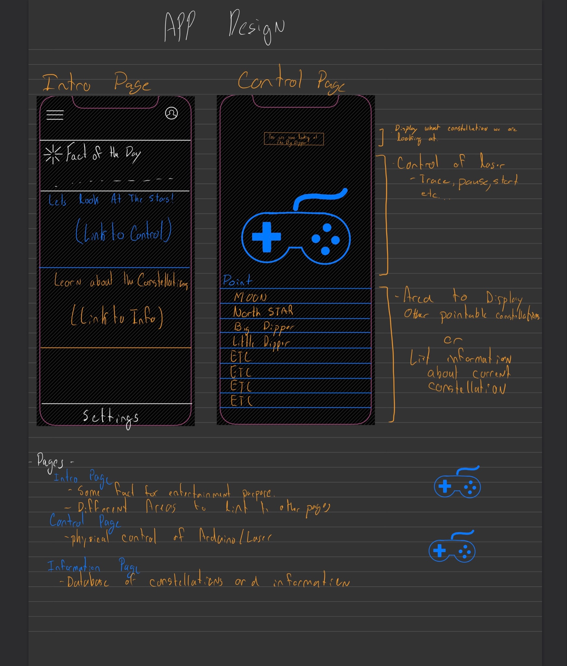
App Design
We started with a pen and pencil drawing of what our app might look.
We sat down with client and group to discuss what features and how UI might look.
Multilingual feature
Notes:
Axel

Slide 24
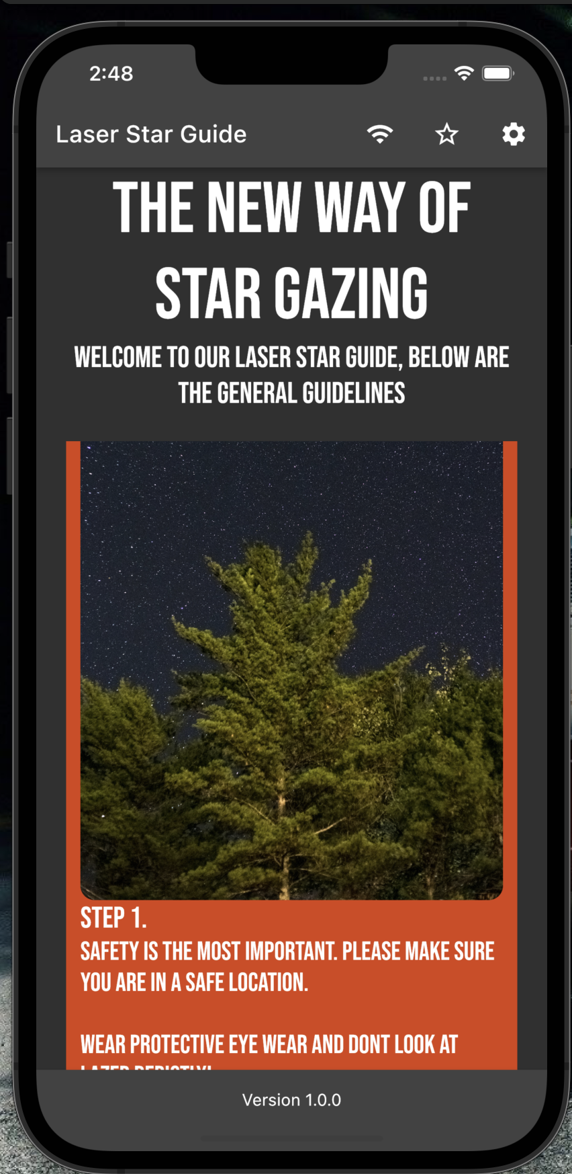
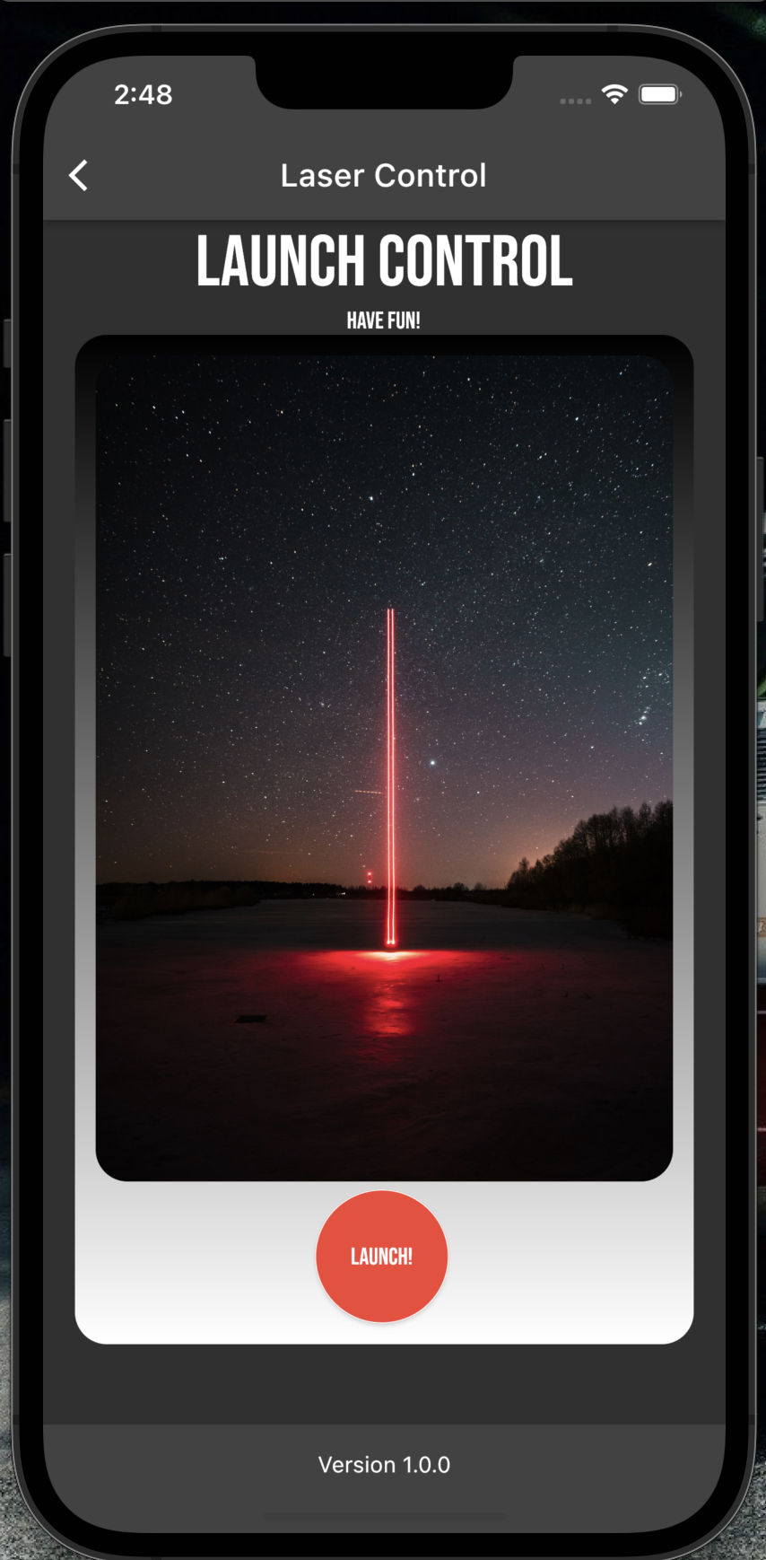
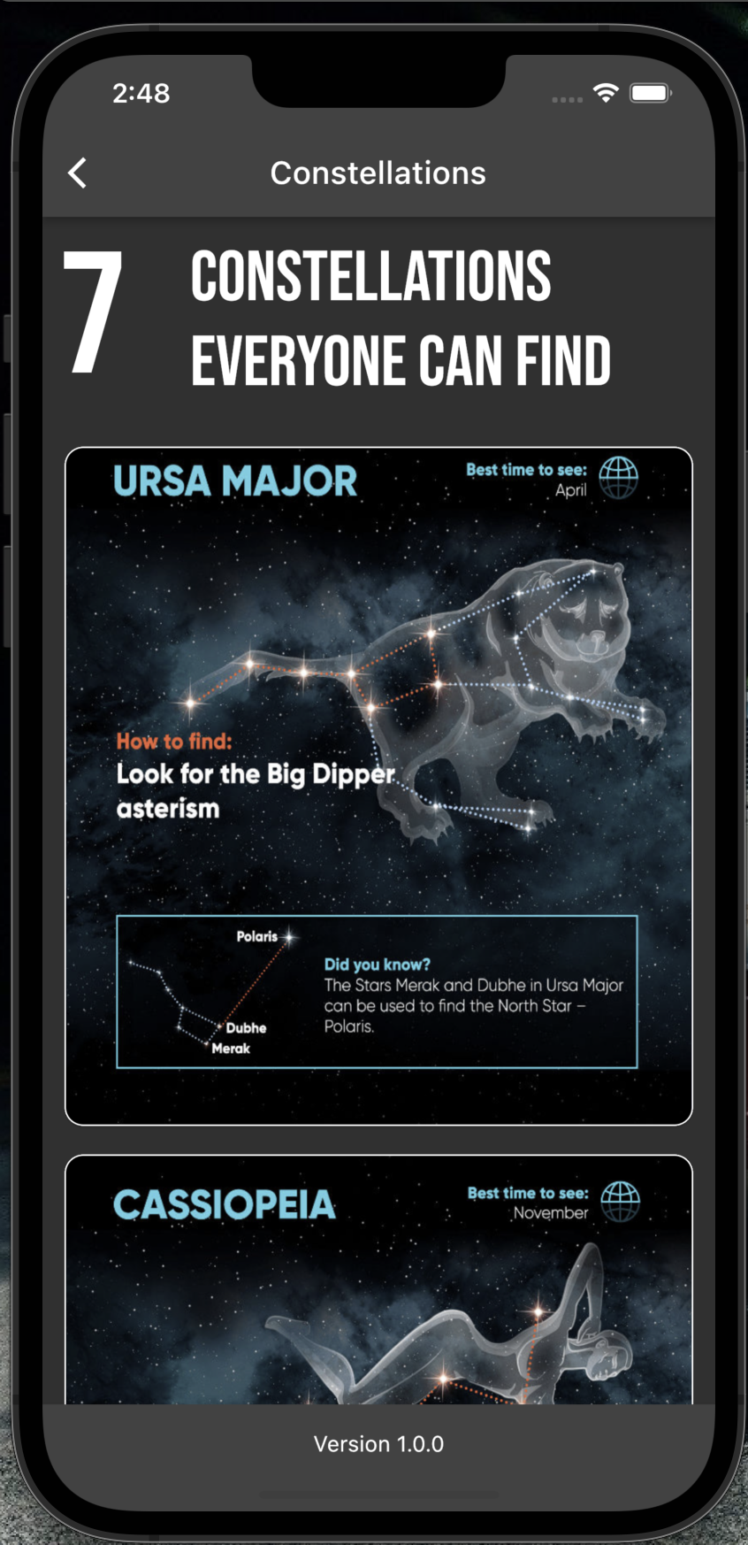
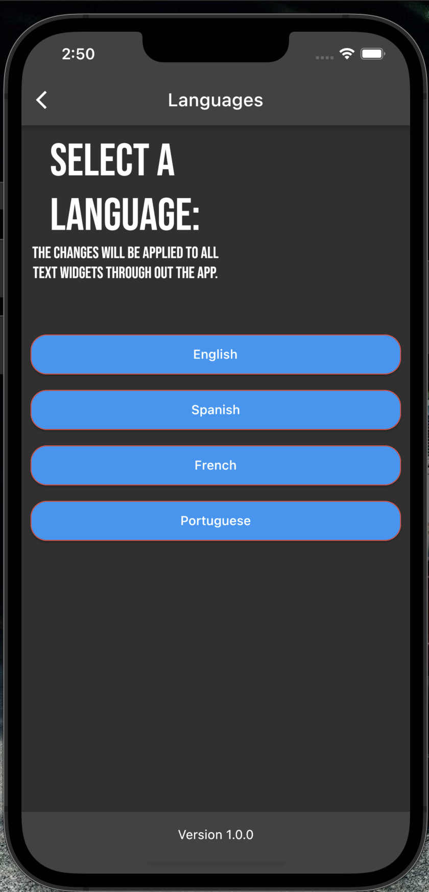
Final Design and UI

Slide 25
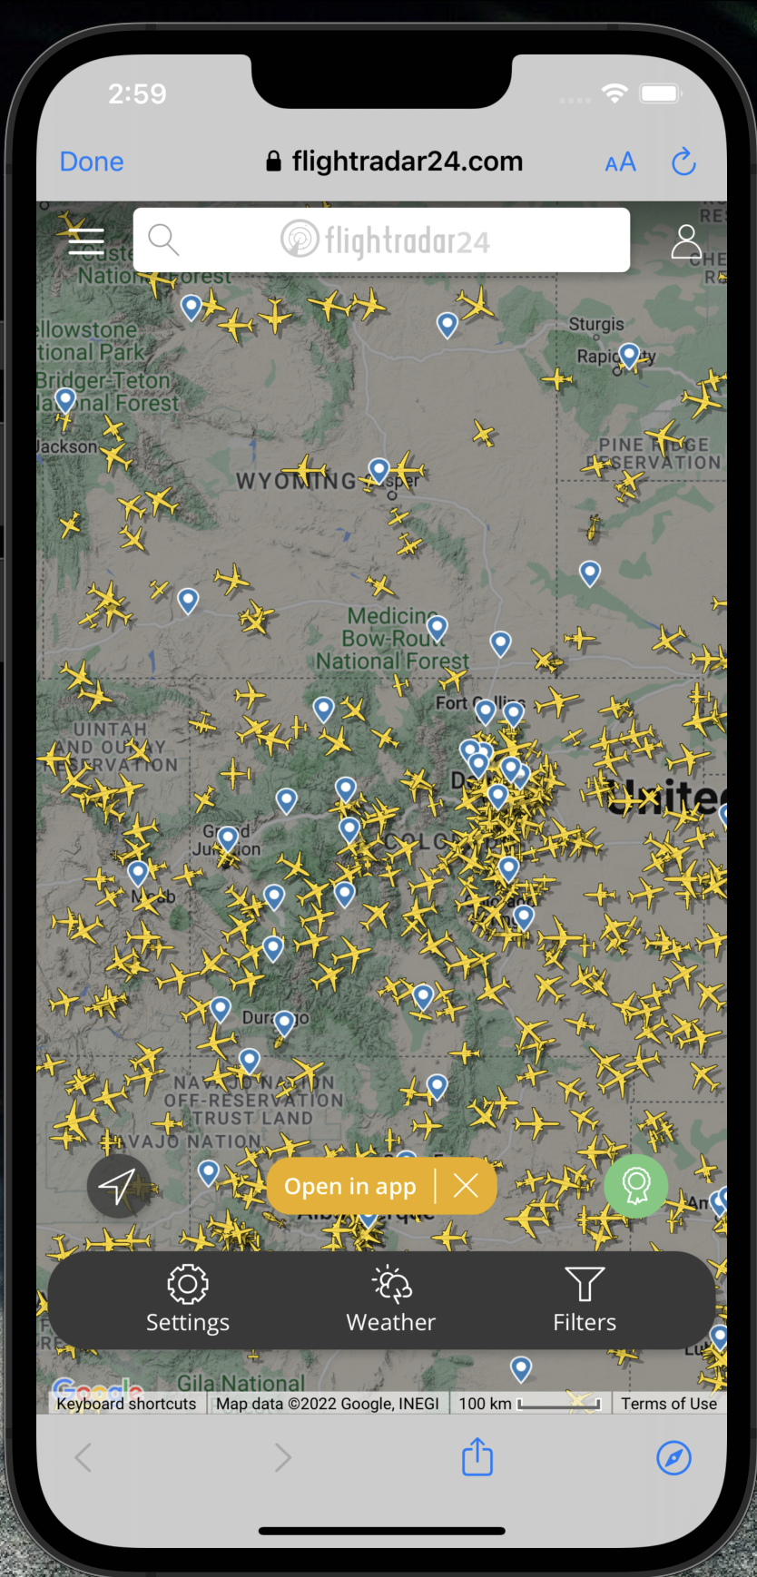
Final Design and UI

Slide 26
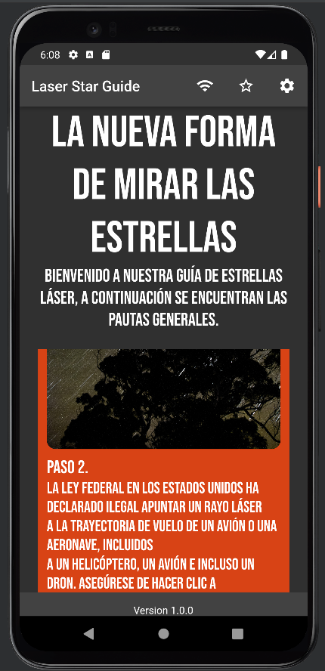
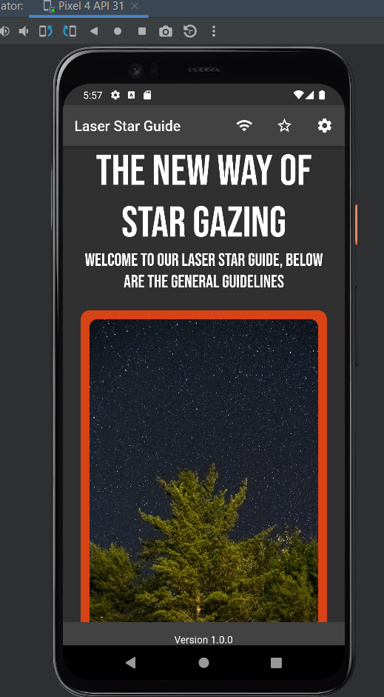
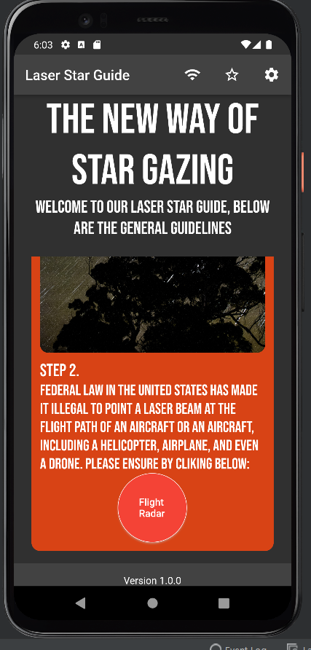
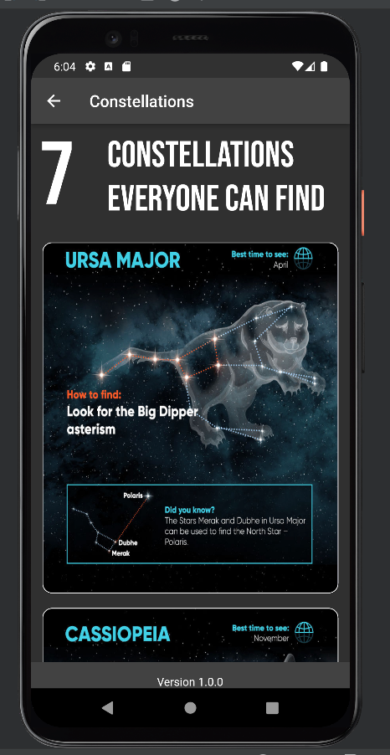
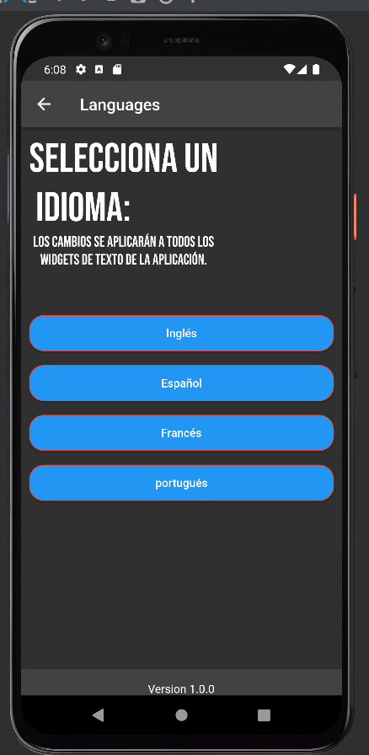
Flutter App running in Android

Slide 27
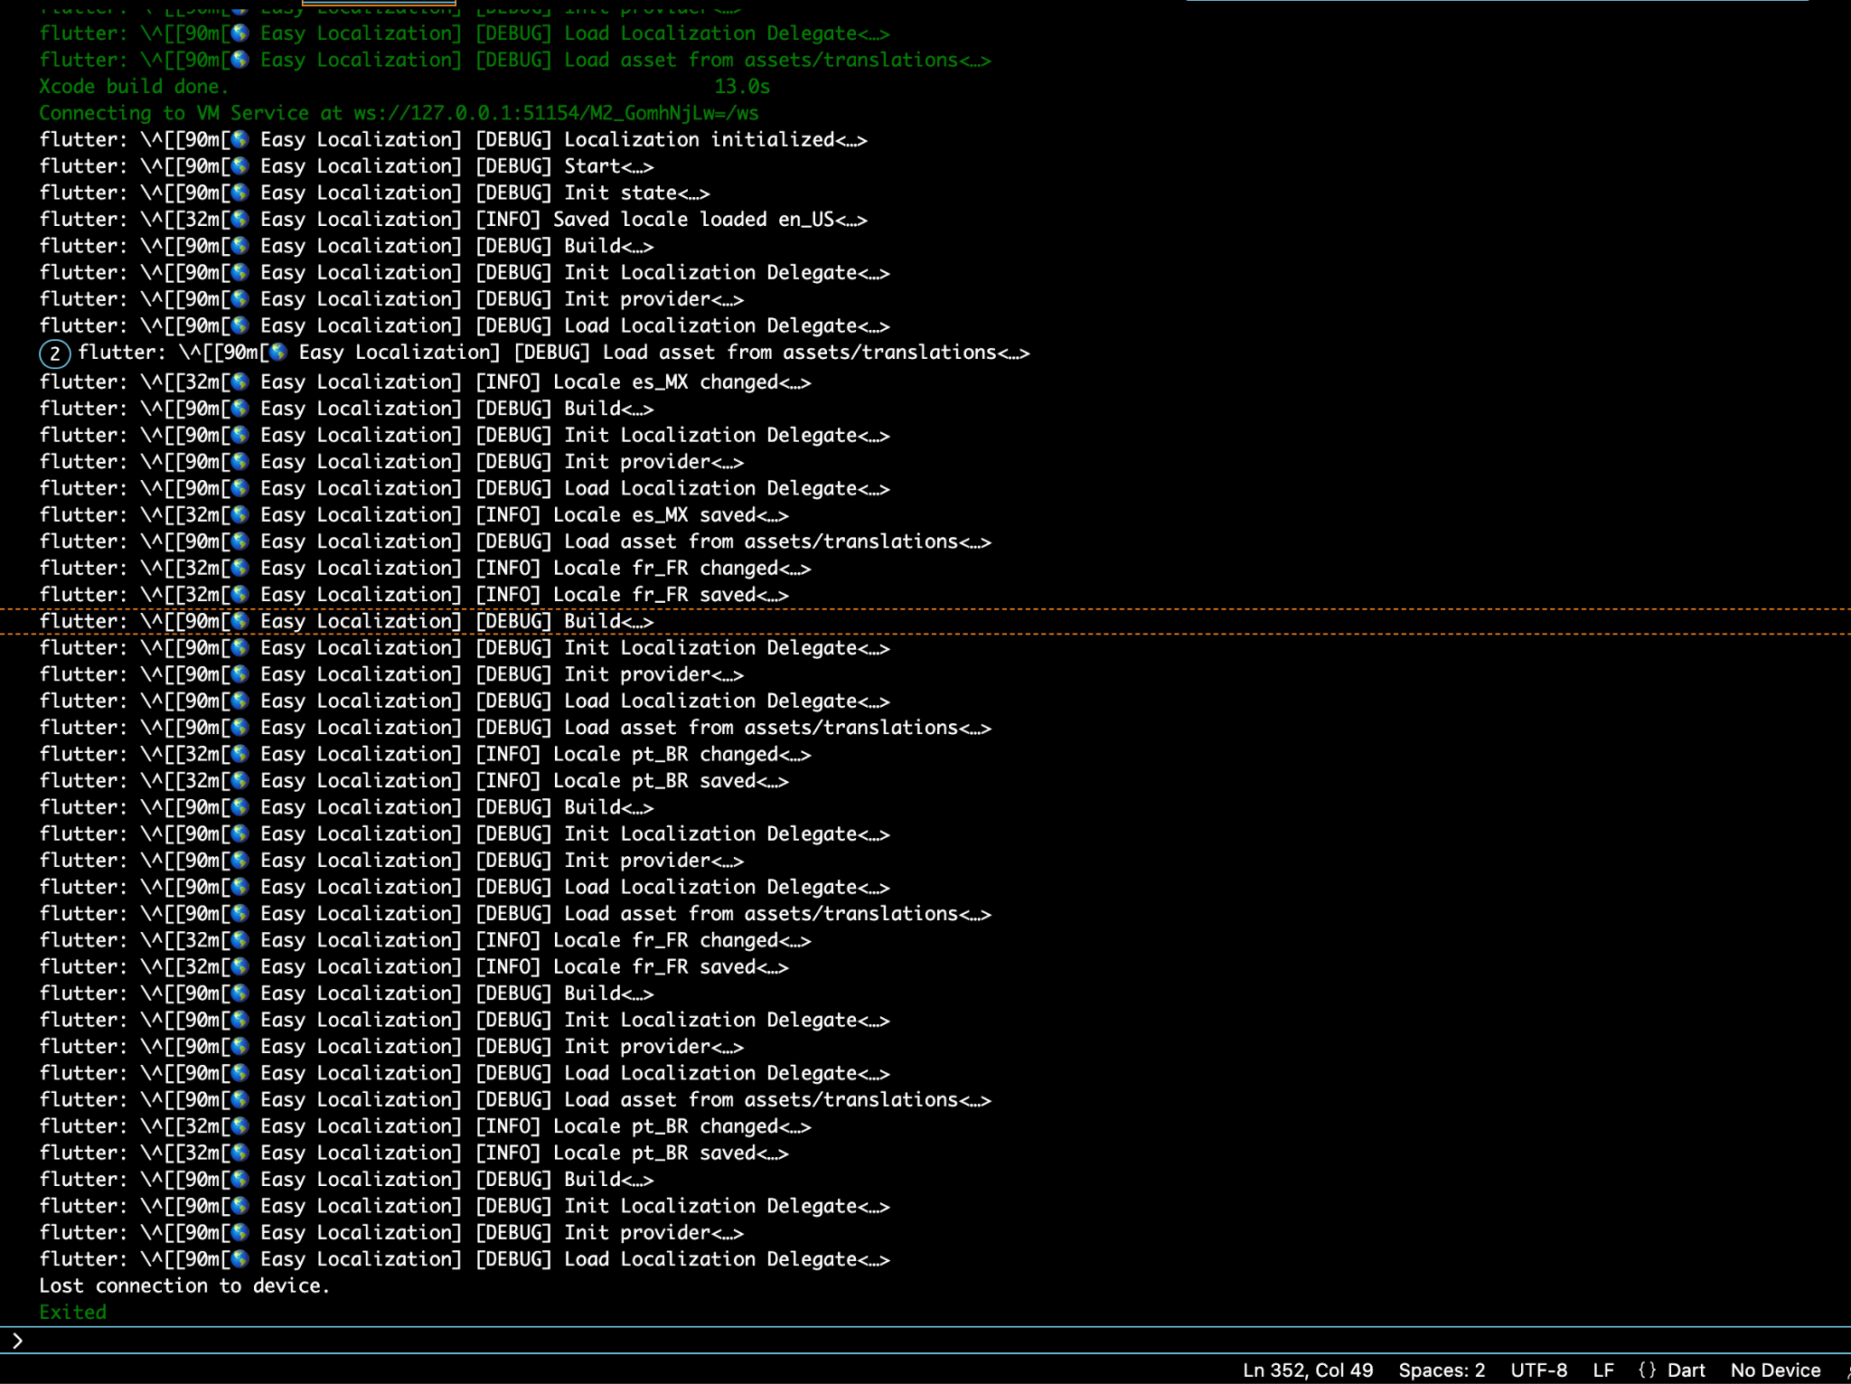
Testing
Flutter Automated Testing: Using Easy Localization Framework.
Notes:
Eddy
This is a demonstration of our testing. We used a framework called easy location. It was used to checking, build, and even test for language changes.

Slide 28
Challenges

Slide 29
Databases
Used a CRUD style database
CREATE
READ
UPDATE
DELETE
Create a database that would work offline.
The idea of a database that worked with a JSON
From there you can insert or delete any kind of constellation that user wants
Some errors that happen was the dependencies would clash with each other
Having an issue with the no internet problem
In the beginning, client wanted to use a stellarium database (from a book)
Notes:
Eddy
Another challenge was creating our database.
in the beginning, our client wanted to use the database that stellarium uses. However, as mentioned before we could get the rights to it and it was too complicated for what we need for our project
So instead we wanted to create a CRUD style database similar to Sqlite.
This is where we get to CREATE, READ, UPDATE, AND DELETE
Since the idea was to make it work offline. CRUD offered that option and the main idea was when the user comes online, it would read the database and send changes to the server. However, the main issue that it was facing was the dependencies wont work/connect or they would interfere with other dependencies/library.

Slide 30
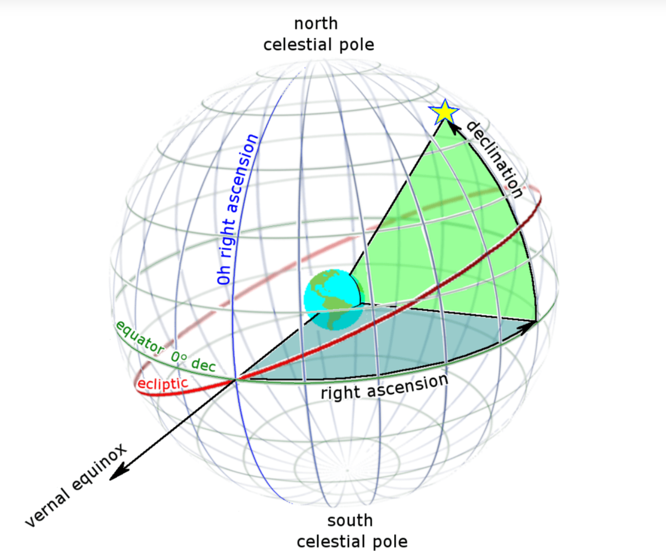
Math
Used celestial coordinates with declination and right ascension
In our design, we planned to point to the north star first.
Then we just work off the angle to get to the next star
up/down (north/south) is known as declination
It is measured in degrees from the celestial equator (runs parallel to Earth’s equator).
left/right (east/west) is known as right ascension (RA)
Measured in hours from zero-hour line (perpendicular to the point where the sun crosses celestial equator at the vernal equinox)
Notes:
Eddy
The math that we used was celestial coordinates with declination (dec·li·na·tion) and right ascension (as·cen·sion).
In our design, we planned to point to the north star first. Then we just work off it with an angle to get to the next star ????????????
up/down (north/south) is known as declination
It is measured in degrees from the celestial equator (runs parallel to Earth’s equator).
left/right (east/west) is known as right ascension (RA)
Measured in hours from zero-hour line (perpendicular to the point where the sun crosses celestial equator at the vernal equinox)

Slide 31
Major Issues We Ran Into
No internet connection (idea) in most cases
Legal issues with lasers and planes
Not able to use flight radar API, and stellarium API w/out internet
Learning curve with learning Flutter, Arduino, ESP8266, CAD programming and lots of time researching
Sickness
Hands on building made it hard to get schedules lined up to work on device.
Notes:
All

Slide 32
Future of Laser Star Guide
Notes:
What We Have Learned
Arduino, Galvos, Esp, Flutter, UI design, Html get requests, Extended knowledge of c++, Teamwork and project design
Stars

Slide 33
Legacy project
We’ve laid the groundwork for this project by doing lots of research and development
Developed prototype for finding constellations and pointing a laser at said location.
Developed prototype for laser projection
Next group can use what we’ve learned to implement the two pieces together.
Notes:
Zack can start then All

